Slide 1
VOTING SYSTEM
GROUP 6
Hanna Mariam Roji(RA2111038010023)
Rohan Jaison Mathew(RA2111038010024)
Shelton D(RA2111038010025)
Muhammed Razeen PA(RA2111038010026)

Slide 2
ABSTRACT
Our project is regarding an election voting system where the user can vote,view the leads as well as the vote count. Online Voting System is developed with the aim of creating a platform which will make voting process easier, allowing citizens above 18 years of age to cast their vote online.

Slide 3
ALGORITHM
STEP 1 - Start
STEP 2 - Declare variables
STEP 3 - Give available choices to the user – to cast vote, find vote count, find leading candidate and to exit
STEP 4 -Take the inputs given by the user
STEP 5 -Display the results
STEP 6 - End the program when the choice is entered by the user

Slide 4
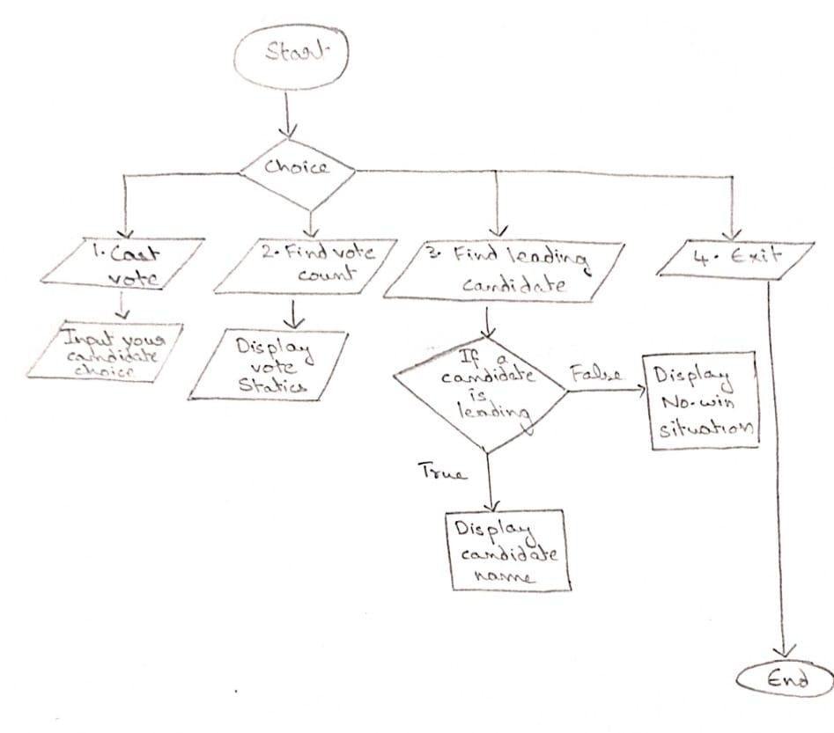
FLOW CHART

Slide 5
Program: #include<stdio.h> #define CANDIDATE_COUNT #define CANDIDATE1 "Shelton“ #define CANDIDATE2 "Rohan“ #define CANDIDATE3 "Muhammed“ #define CANDIDATE4 "Hanna“ int votesCount1=0, votesCount2=0, votesCount3=0, votesCount4=0, spoiledtvotes=0; void castVote() {int choice; printf("\n\n ### Please choose your Candidate ####\n\n"); printf("\n 1. %s", CANDIDATE1);printf("\n 2. %s", CANDIDATE2);printf("\n 3. %s", CANDIDATE3); printf("\n 4. %s", CANDIDATE4); printf("\n 5. %s", "None of These"); printf("\n\n Input your choice (1 - 4) : "); scanf("%d",&choice);switch(choice) { case 1: votesCount1++; break; case 2: votesCount2++; break; case 3: votesCount3++; break; case 4: votesCount4++; break; case 5: spoiledtvotes++; break; default: printf("\n Error: Wrong Choice !! Please retry"); getchar();} printf("\n thanks for vote !!"); }

Slide 6


Slide 7
